Slide 1
glTF 2.0 Renderer – WebGPU (GLSL + gl-Transform)
Live Demo (Use Chrome/Edge Canary): https://gltf-webgpu.netlify.app/
(Charles) Zixin Zhang
https://github.com/zixin96/gltf-webgpu-viewer

Slide 2
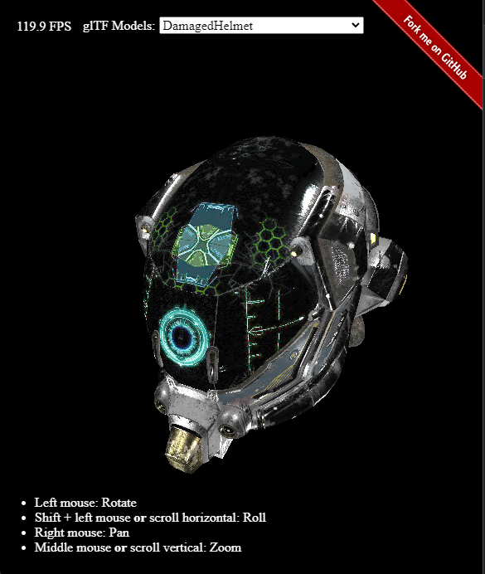
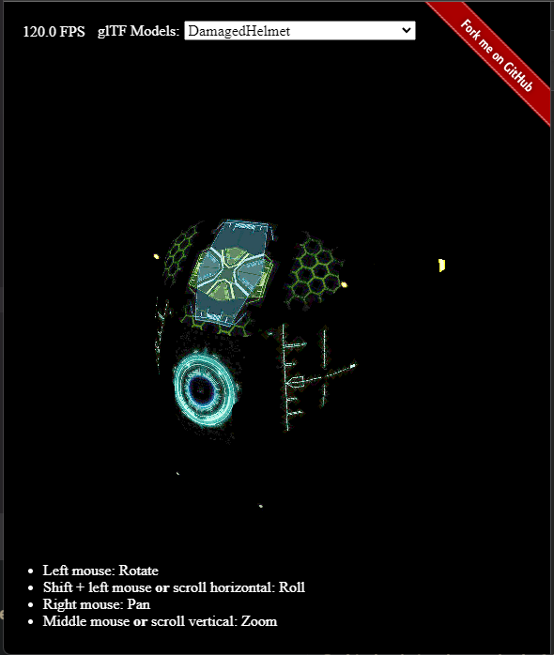
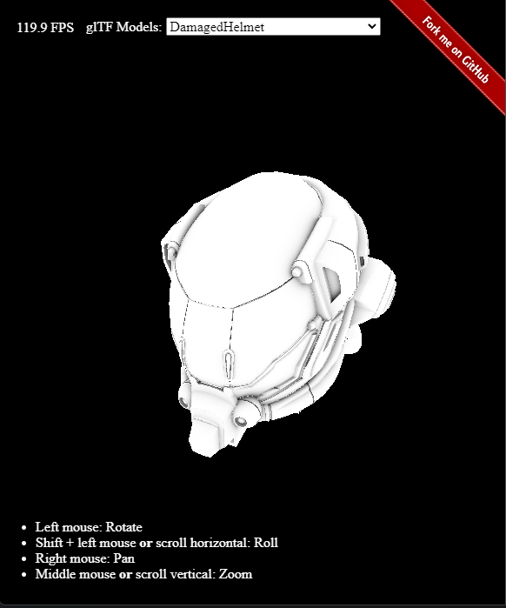
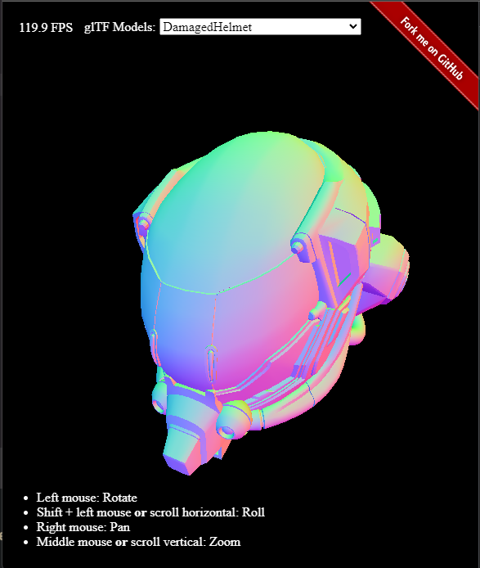
What is this project?
Live Demo (Use Chrome/Edge Canary): https://gltf-webgpu.netlify.app/
glTF provides data…
+
+
+… =
Emissive
Occlusion
Normal Geometry
Goal

Slide 3

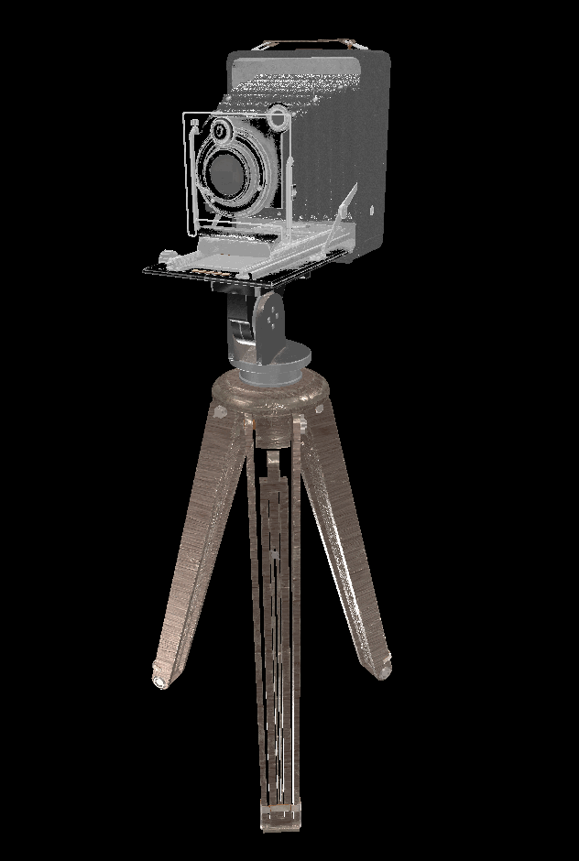
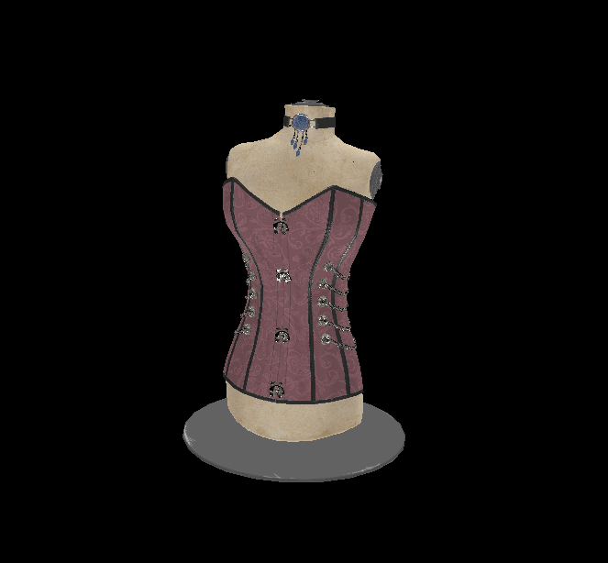
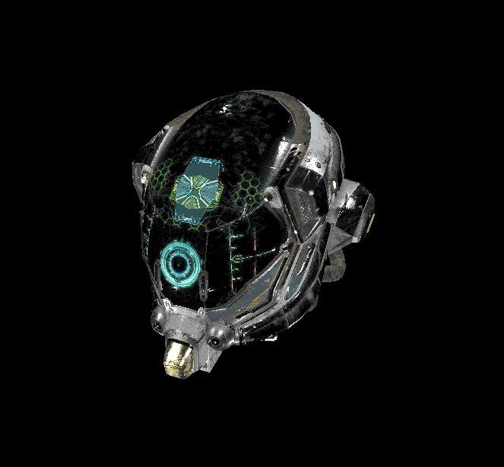
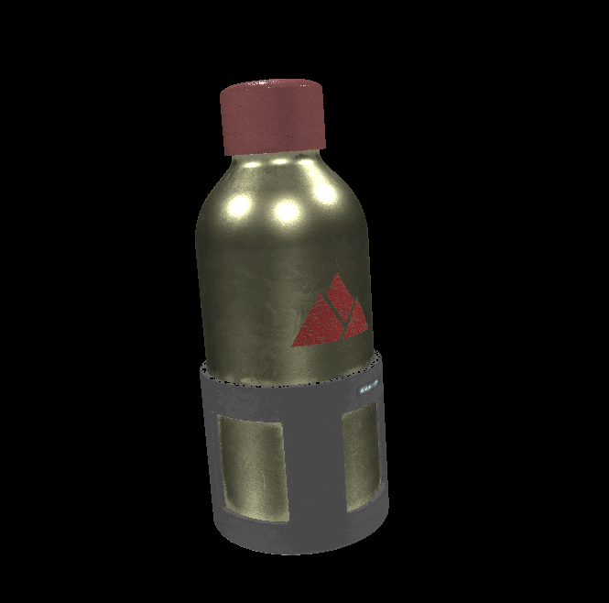

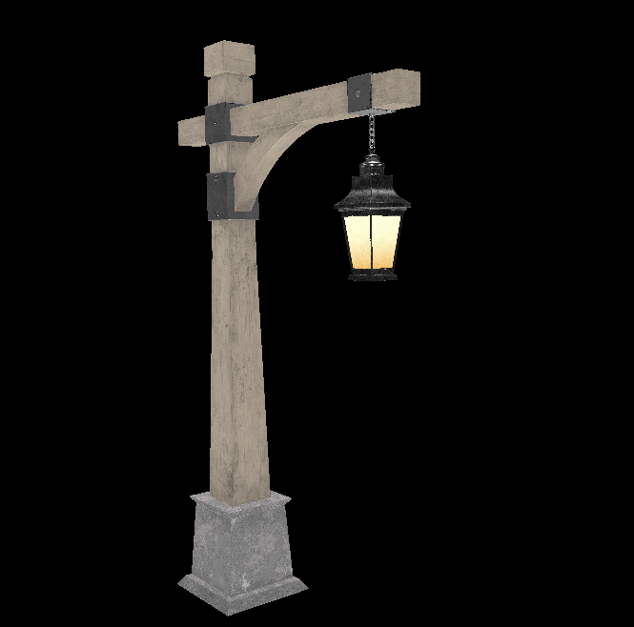
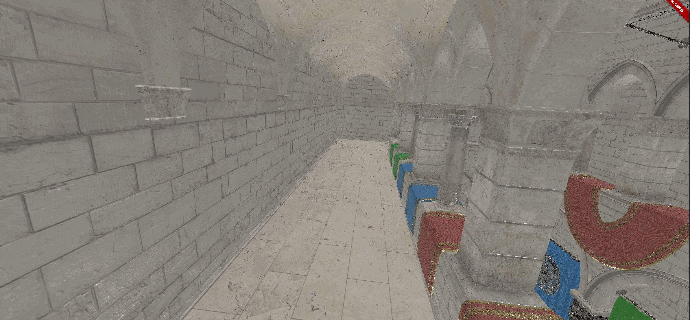

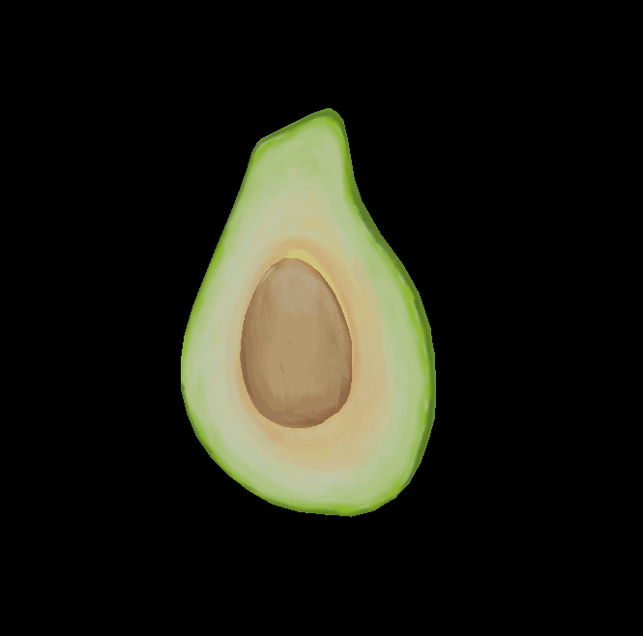
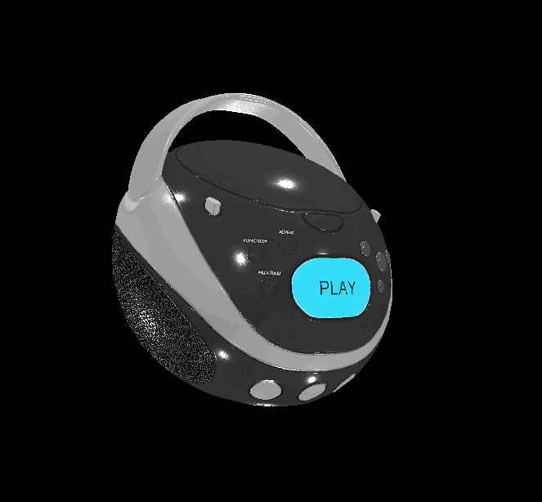
Supported Features/Models
Live Demo (Use Chrome/Edge Canary): https://gltf-webgpu.netlify.app/
Core glTF 2.0 Sample Models
Standard glTF 2.0 Sample Models (except for animation and skin)
Extensions: KHR_lights_punctual
Selected Demo:

Slide 4
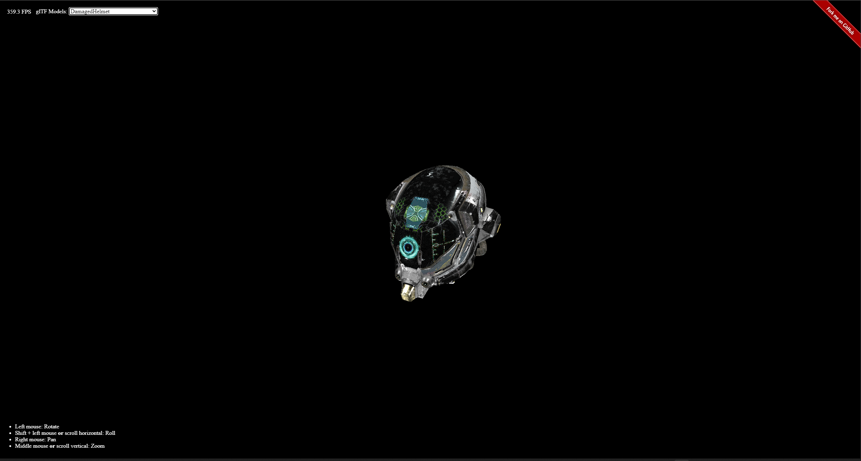
Live Demo (Use Chrome/Edge Canary): https://gltf-webgpu.netlify.app/
Live Demo

Slide 5
Components
Live Demo (Use Chrome/Edge Canary): https://gltf-webgpu.netlify.app/
gl-Transform by Don McCurdy
JavaScript Library for reading 3D models in glTF 2.0 format
@webgpu/glslang by Kai Ninomiya
GLSL-to-SPIR-V compiler so that we can use GLSL in WebGPU
3d-view-controls by Mikola Lysenko
An easy-to-use 3D camera providing ViewProjection matrices
WebGPU Renderer + Shaders

Slide 6
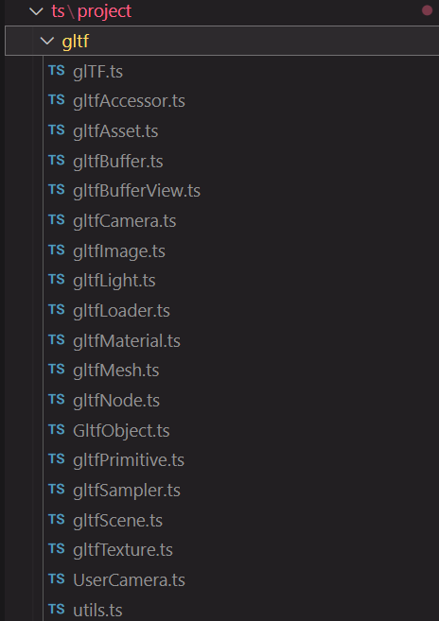
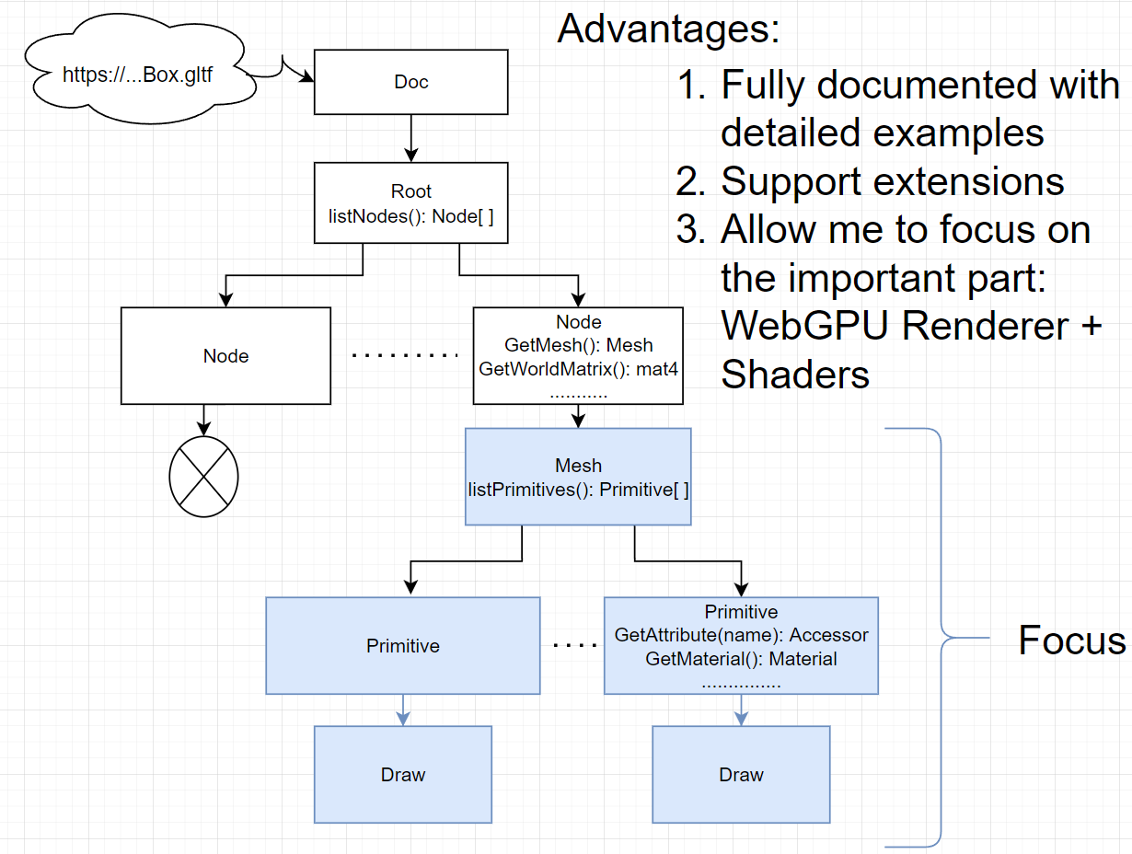
gl-Transform
Live Demo (Use Chrome/Edge Canary): https://gltf-webgpu.netlify.app/
Implement glTF loader from scratch:
Use gl-Transform:
“Don’t reinvent the wheel”
Notes:
Bad from scratch:
Successfully loads a MR box, however, going from box to texturedBox seems easy, but exactly very difficult, since it requires modifying/adding many files. It is complex, and will get even harder when we have more complex models. It’s error-prone and time-consuming. I want to spend more time on renderer and shaders, rather than on the gltf files. This is why I decide to search for a library.
Disadvantage of gl-transform:
dependency. Code tied to gl-Transform, but the author actively maintains the lib, last commit is 12/10

Slide 7
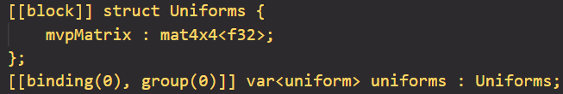
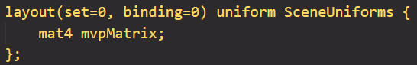
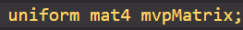
WGSL vs GLSL vs GLSL (WebGL)
Live Demo (Use Chrome/Edge Canary): https://gltf-webgpu.netlify.app/
WGSL:
Higher Complexity
GLSL:
WGSL
GLSL
GLSL (WebGL)
Conversion is doable
Conversion is nontrivial
GLSL (WebGL):
Notes:
By doable: Do not need to modify the renderer code if you switch from GLSL to WGSL. All modifications are done in shaders

Slide 8
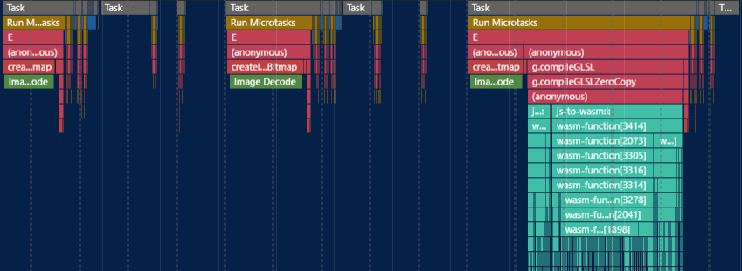
Limitations
Live Demo (Use Chrome/Edge Canary): https://gltf-webgpu.netlify.app/
Slow load time for large data sets
However, it works fine for small data sets in extension scenes such as Dragon Attenuation
and Sheen Cloth
GLSL to SPIV-V takes time!

Slide 9
Roadmap
Live Demo (Use Chrome/Edge Canary): https://gltf-webgpu.netlify.app/
Support for more extensions: start with KHR_materials_sheen
Support for animation and skin
Improve load time for large data sets
Use WGSL for large data sets with less complex shader code
Use GLSL for small data sets with more complex
shader code

Slide 10
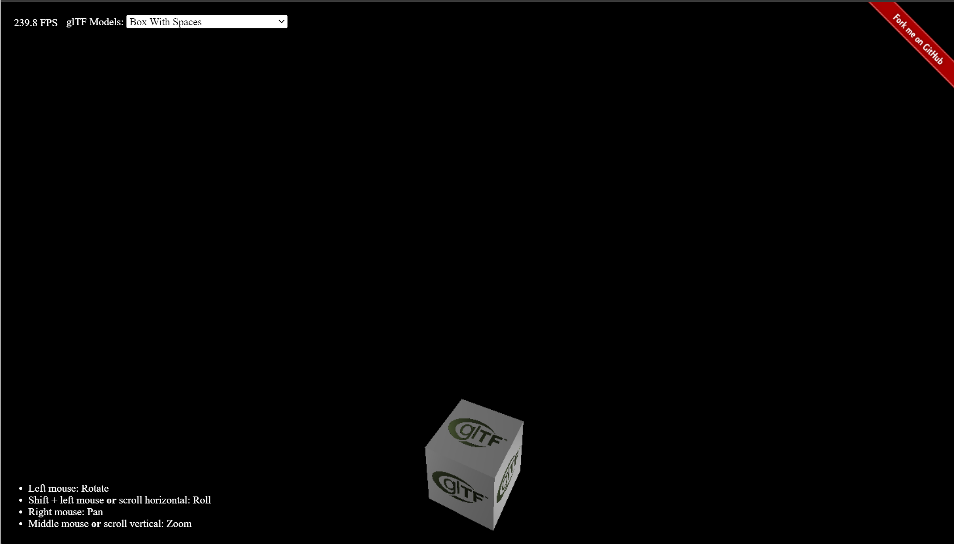
Acknowledgements
Live Demo (Use Chrome/Edge Canary): https://gltf-webgpu.netlify.app/
Thank you to all the authors below for making this project possible.
KhronosGroup/glTF-Sample-Viewer for providing a wonderful place to study glTF renderer. Importantly, the shader source codes are derived from this project.
glTF-Transform by Don McCurdy for providing an easy-to-use SDK for loading and reading glTF files.
kainino0x/glslang for providing a way to use GLSL shaders in WebGPU.
mikolalysenko/3d-view-controls for providing a user-friendly camera system.
Practical WebGPU Graphics by Jack Xu, PhD for introducing me to the world of WebGPU and providing the base code for this project.
The Complete JavaScript Course 2022: From Zero to Expert! by Jonas Schmedtmann for teaching me what "async/await" means and the fundamental of Javascript. Highly recommend this course!
Understanding TypeScript - 2022 Edition by Maximilian Schwarzmüller for teaching me those finer details about Typescript.
(Charles) Zixin Zhang
zixinzha@seas.upenn.edu
https://github.com/zixin96

